Slide 1
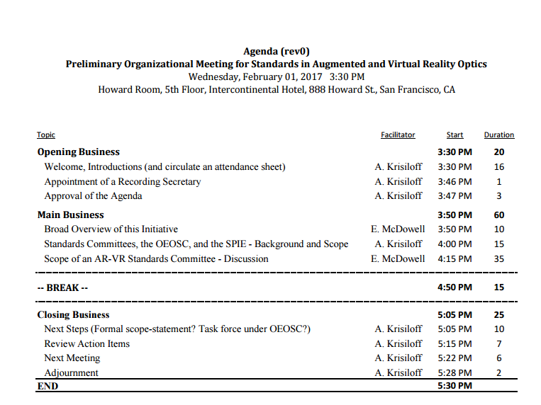
Notes:
First meeting to determine whether an AR/VR standards meeting makes sense, and if so… what is the scope, where is the home, and how do we proceed.

Slide 2
Standards Committee
Standards help to remove technical barriers to trade, leading to new markets and economic growth for the industry
Technology Development, Design
Supply Chain
Product (Consumer adoption)
"When you have common interfaces and common protocols, everyone can innovate and interoperate. Companies can build their businesses, consumers can expand their choices, technology moves forward faster, and users get more benefit...“
“People often take the view that standardization is the enemy of creativity. But I think that standards help make creativity possible—by allowing for the establishment of an infrastructure, which then leads to enormous entrepreneurialism, creativity, and competitiveness.” Vint Cerf, TCP/IP co-developer
Notes:
Baseline – why have a standards group.

Slide 3
Notes:
How devices are currently compared in the industry (this is from Lux research).
The definitions of terms such as FOV are not clear. Comparisons are therefore not really clear either.

Slide 4
Lux research ranking table
Notes:
Is it this simple? Is a FOV of 150 better than FOV of 95 if the image is poor?

Slide 5
Notes:
Just the summary from Lux. Nice data to look at for those of us who are familiar with the products, but oversimplification for anyone who really wants to see which products are “best in class” vs. “Likely losers”.

Slide 6
Devices | Requires | Display | Resolution | Refresh Rate | Field of View | Tracking | Rotational Tracking | Positional Tracking | Update Rate | Latency
ANTVR | PC Xbox One PlayStation 4 Smartphone | Aspherical lens | 1920 x 1080 |  | 100° diagonal | 3DOF | Gyroscope Magnetometer Accelerometer
Daydream View | Daydream Ready Phones | 5 / 5.5 inch AMOLED (Pixel / Pixel XL) | 1920 x 1080 / 2560 x 1440 (Pixel / Pixel XL) | 60 Hz Low-persistence | 90° (nominal) | 3DOF | Accelerator Gyrometer Proximity | None | Rotational: 1000 Hz High accuracy | Motion to Photon: Less than 20 ms
FOVE | PC | 5.8 inch low persistence OLED | 2560 x 1440 | 60 - 90 Hz | 100° | Eye Tracking | IMU | Their own system | Eye Tracking: 120 FPS
Google Cardboard | Smartphone | Depends on the smartphone | Depends on the smartphone |  |  | 3DOF | IMUs in Smartphone | None
HTC Vive | PC | Dual Panel | 2160 x 1200 (1080 x 1200 per eye) | 90 Hz | 110° (diagonal) | 6DOF | Gyroscope Accelerometer Laser Position Sensor | Base Stations | Rotational: 1000Hz Positional: 60Hz | ??
Impression Pi | Smartphone | Depends on smartphone | Depends on the smartphone |  |  | 6 DOF | IMU Board | IMU Board Infared Cameras? IR Projector?
LG 360 VR | LG G5 | 1.88" IPS LCD x 2 EA 920 x 720 per Eye 639 ppi Real RGB | 960x720 pixels at 693ppi (per eye)
OSVR HDK1 | PC | 5.5 inch LCD (1.0) 5.5 inch low-persistence OLED (1.1 - 1.3) | 1920 x 1080 960 x 1080 per eye | 60 Hz (1.0 - 1.2) 120 Hz (1.3) | 100° (nominal) 90° (H and V) | 3DOF 6DOF | Gyroscope Accelerometer Magnetometer | IR-LED faceplate and External Infrared Camera | Positional: 100 Hz Rotational: 400Hz | ??
Oculus Rift DK2 | PC | 5.7 inch OLED (PenTile) | 1920 x 1080 960 x 1080 per eye | 75 Hz 72 Hz 60 Hz | 100° (nominal) | 6DOF | Gyroscope Accelerometer Magnetometer | Separate Camera Near Infrared CMOS Sensor | Rotational: 1000 Hz Positional: 60 Hz | ~30 ms
PlayStation VR | PlayStation 4 | 5.7 inch OLED | 1920 x 1080 960 x 1080 per eye | 120 Hz 90 Hz | 100° | 6DOF | Accelerometer Gyroscope | PlayStation Camera | ? | Less than 18ms
Samsung Gear VR | All Samsung Smartphones 2015 and newer | 5.7 / 5.1 inch Super AMOLED (RGBG PenTile) | 2560 x 1440 1280 x 1440 per eye | 60 Hz Low-persistence | 96° (nominal) | 3DOF | Accelerator Gyrometer Proximity | None | Rotational: 1000 Hz High accuracy | Motion to Photon: Less than 20 ms
StarVR | PC | Dual 5.5" LCD Quad HD Displays | 5120 x 1440 (2560 x 1440 per eye) |  | 210° (horizontal) 130° (vertical) | 6DOF | Gyroscope Accelerometer Magnetometer | External optical sensor with fiducial markers
Notes:
Another report that compares various products (don’t recall the source)

Slide 7
You are here.
Intro Meeting
Current Standards efforts for AR/VR
Identify Initial scope
AR/VR
Optics?
Display?
Content?
Opthalmic?
Find Standards Home(s)
SPIE (OEOSC) Optical Components and Systems
SID Display
ISO
IEEE Communications
The Vision Council Opthalmic
Industry Participants
Companies
Individuals who want to be in the Working Group
Notes:
What do we want to do in the standards committee?
Where shall it be
Who should participate?

Slide 8
Augmented Reality, Virtual Reality
Field of View (Vertical, Horizontal ……..
Vignetting
Resolution
Contrast
Distortion
Magnification
Chromatic aberrations
Light Leakage
Optical Defects
Focus
Latency
Smear
Judder
Eye tracking?
Roll-off
Birefringence
Glare
Architecture
Eye
Optics
Display
Real World (AR)
Hardware (tracking, motion, etc.)
Software
Notes:
How far do we want to go? Optics or the complete system?
Where do we start so we don’t make it too complex from the get-go?

Slide 9
FOV
Monocular FOV describes the field of view for one of our eyes. For a healthy eye, the horizontal monocular FOV is between 170°-175° and consists of the angle from the pupil towards the nose, the nasal FOV which is usually 60°-65° and is smaller for people with bigger noses, and the view from our pupil toward the side of our head, the temporal FOV, which is wider, usually 100°-110°.
Notes:
As an example, what does FOV mean? Here is one definition.

Slide 10
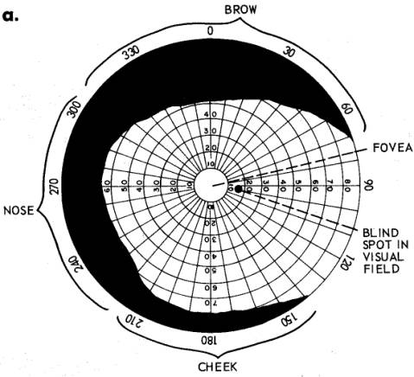
Field of View w Central Fixation
Monocular FOV :
nasal : 60°-65°
temporal : 100-110°
upward : 60°
downward : 70-75°
horizontal : 170°-175°
vertical : 135°
Binocular FOV :
horizontal : 200-220°
vertical : 135°
stereoscopic : 114°
Humans have an almost 180-degree forward-facing horizontal field of view. The vertical range of the field of view in humans is typically around 135 degrees
Monocular FOV describes the field of view for one of our eyes. For a healthy eye, the horizontal monocular FOV is between 170°-175° and consists of the angle from the pupil towards the nose, the nasal FOV which is usually 60°-65° and is smaller for people with bigger noses, and the view from our pupil toward the side of our head, the temporal FOV, which is wider, usually 100°-110°.
https://vrwiki.wikispaces.com/Field+of+view
Notes:
However, FOV isn’t really just one number. Furthermore, perhaps the definitions should relate to the eye, and not be seen as independent to the eye.
Can a system have a greater FOV than an eye?

Slide 11
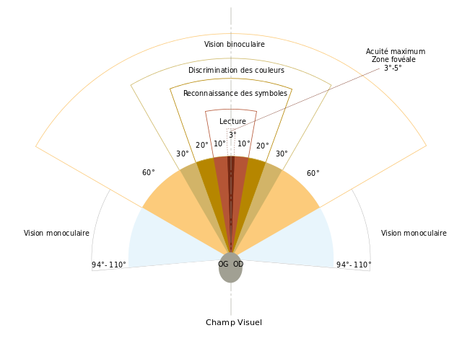
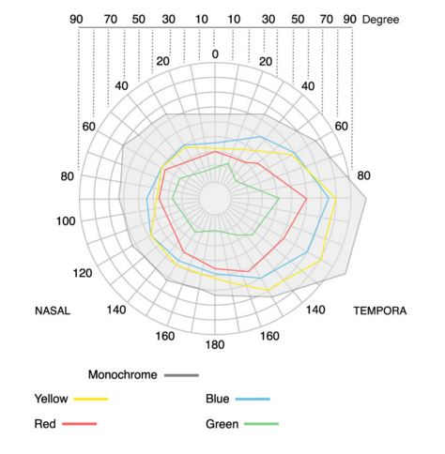
Human Field of View
https://vrwiki.wikispaces.com/Field+of+view
https://vr-lens-lab.com/field-of-view-for-virtual-reality-headsets/
Notes:
Does FOV include various segments for resolution, or for color? Does resolution need to be uniform or can it be lower in areas where human eye resolution is lower?

Slide 12
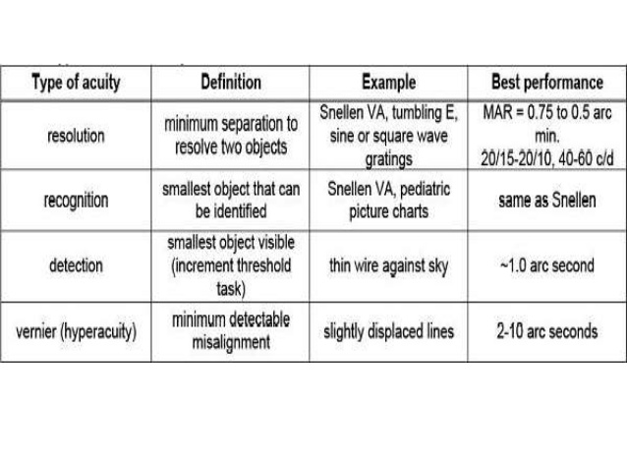
Visual Acuity (Human Eye Tests)
Field of View
Astigmatism
Distortion
Contrast
Notes:
Just some thoughts on next slides
Maybe we need to base some of the system definitions off of human eye tests? What’s the best a human eye can resolve in various AR/VR systems as compared to natural vision?

Slide 13
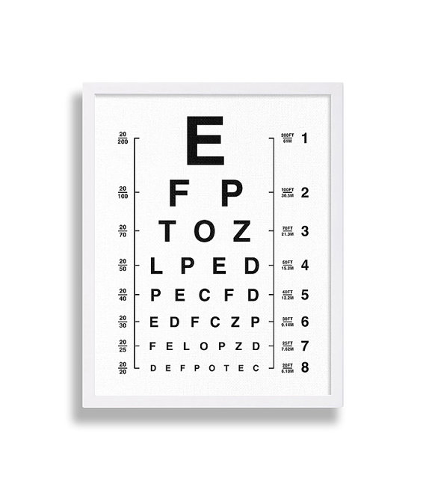
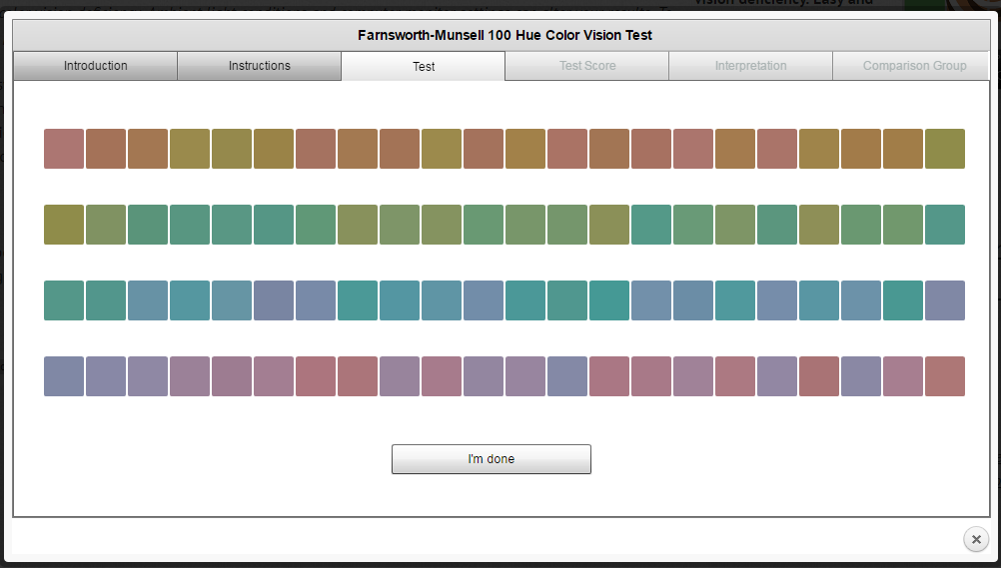
Contrast
Color Hue
Resolution
Pelli-Robson Contrast Sensitivity Chart
Notes:
Here’s some human eye tests. It would be interesting to integrate these into some of the test methodologies

Slide 14
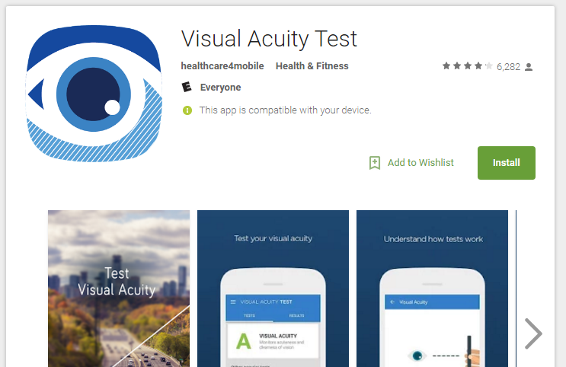
Notes:
Maybe at some point we can have an app that allows users to test their “VR-sight” or “AR-sight”

Slide 15
ANSI/OEOSC OP – Optics and Electro-Optical Instruments
Participants: 65 Voting Members: 43 Observing Members: 7 Alternates: 15
Scope Standardization of terminology, requirements, interfaces and test methods in the field of optics. This includes complete systems, devices, instruments, optical components, auxiliary devices and accessories, as well as materials.
Excluded: Standardization for specific items in the field of cinematography (SMPTE), photographic apparatus (ANSI/NAPM IT3), ophthalmic lenses (ANSI/Z80), eye protectors (ASTM), micrographics (ANSI/AIIM C23), fiber optics for telecommunication (ANSI/EIA/TIA FO-6.3) and electrical safety of optical elements.
Notes:
The current standards committee. Do we fit here? Or SID? Or both?

Slide 16
Recommendations from this room.
Intro Meeting
Identify Initial scope
  AR and VR? One or More committees?
  What part of the architecture?
Standards Home(s)
Industry Participants
  Recruiting/Informing
  ID Individuals for the Working Group (Qualifications?)
Notes:
What’s next?

